Slide 1






Chicago Taxi Ride Analysis
Team 7:
Prateek Naharia
Tyler Christoforo
Linting Wang
Sifan Zhu
Jiadai Yu

Slide 2
Table of Contents
01
02
03
Project Objective
Dataset Description
Key Findings
& Analysis
04
Conclusion

Slide 3

Problem Objective
After Uber and other platforms took over the taxi market, it has left traditional taxi services quite vulnerable
Focus on traditional taxi services
Analyze trends and patterns in the industry
Determine potential opportunities
Develop business decisions relating to taxi pricing, operation, and marketing

Slide 4


Dataset
Description
Data source: Recorded by
City of Chicago's regulatory agency
https://data.cityofchicago.org/Transportation/Taxi-Trips/wrvz-psew
Total Columns: 22 columns
Fare
Tips
Duration
Tolls
Pick-up & Drop-off Location
...
Total Rows: 206,021,251 entries
81 traditional taxi companies
From 2013 to the current date
Updated regularly
Notes:
1

Slide 5
Data Cleaning
Problem
Approach
Hard to manipulate due to data size
A significant amount of null values
Long run times
Partition the full data into sets
Standard imputing, drop if fail
Create problem specific dataframes
Note:
Filter down earlier years with incomplete documentation and missing entries
 | # of Existing high null count variables | Max number of null counts
2013 | 11 | 11,221,939
2014 | 10 | 12,508,340
2015 | 10 | 11,458,239
2016 | 10 | 11,130,667
2017 | 9 | 8,134,193

Slide 6
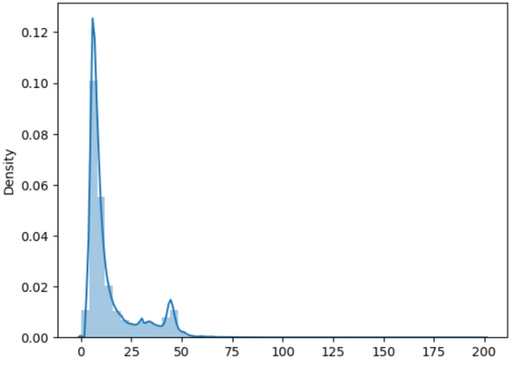
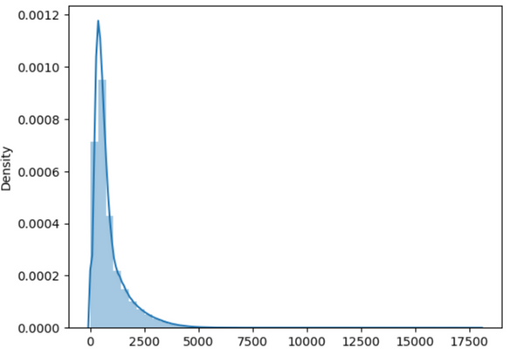
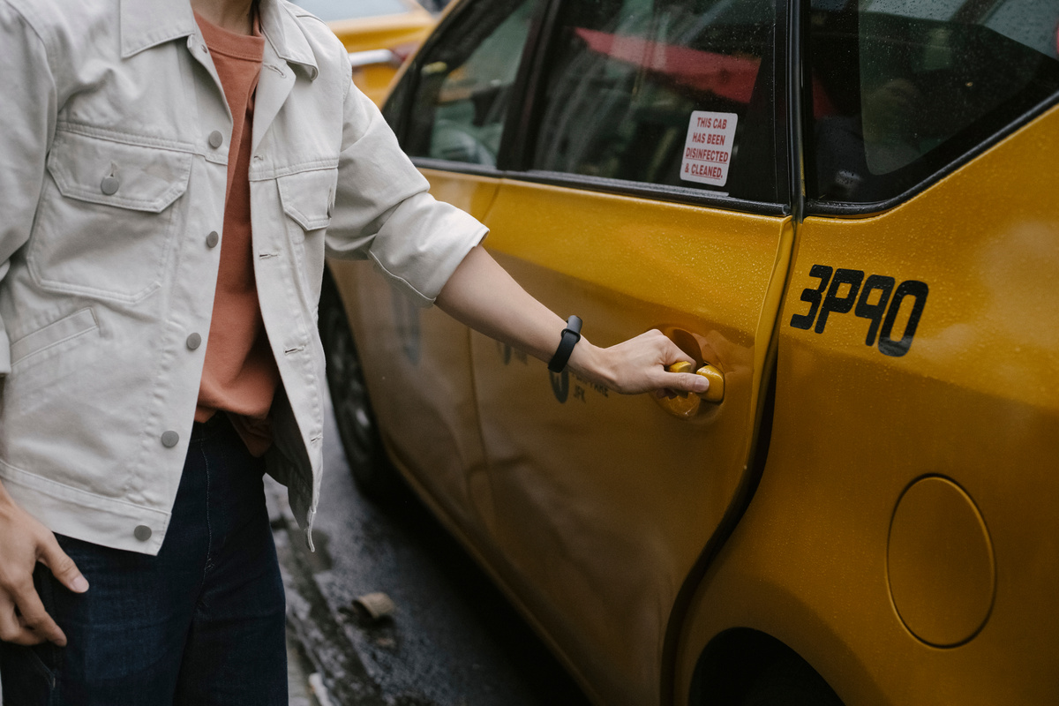
The Current Market
-- CONSUMER BEHAVIOR AT A GLANCE
Price points customers are more likely to take a taxi
Common duration of taxi trips
$10
15 mins
$45
Trip Fare Distribution
Trip Total Seconds Distribution

Slide 7
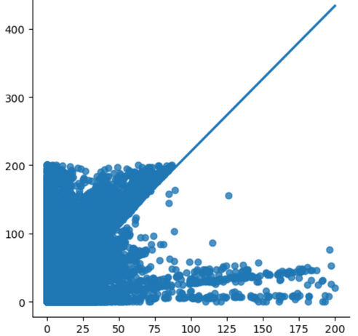
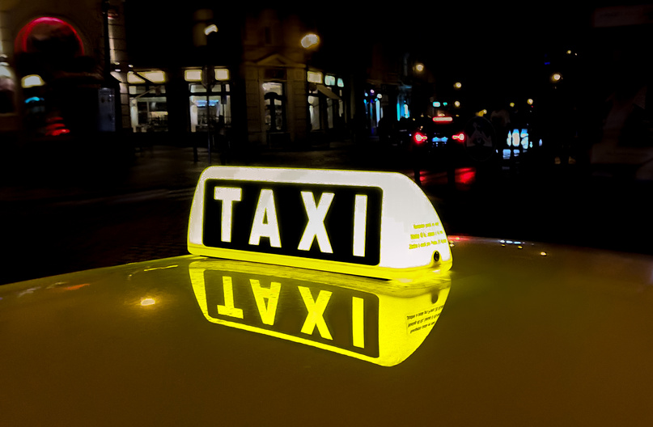
The Current Market
-- CORRELATIONSHIP BETWEEN FARE AND MILES
Different pricing strategies
For trips under 60 miles, fares vary widely, ranging from 0 to 200 dollars (traffic and tolls)
For trips longer than 60 miles, distance is the key factor
FARE
MILES

Slide 8
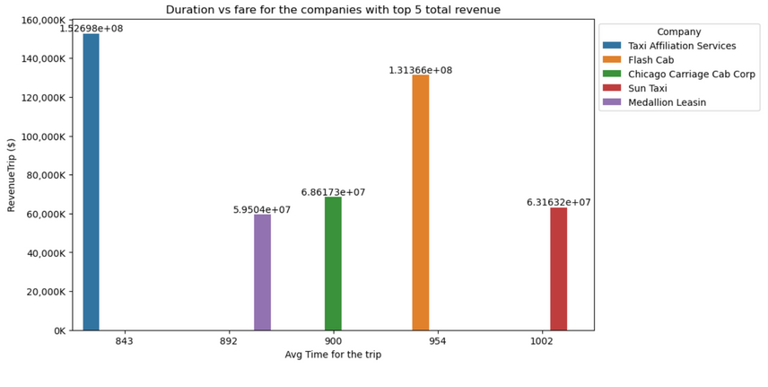
Top Performing Companies
-- THE COMPANIES CAPITALIZING WELL ON THE MARKET
Companies with top5 revenue have no relationship with trip duration

Slide 9
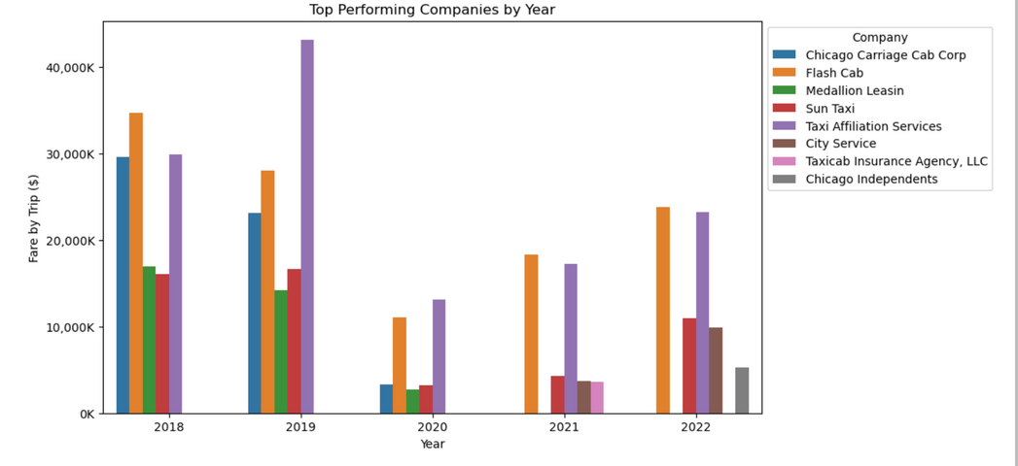
Top Performing Companies
-- THE COMPANIES CAPITALIZING WELL ON THE MARKET
Bigger players tend to stay in the market lead
Some companies exit the market or get acquired

Slide 10
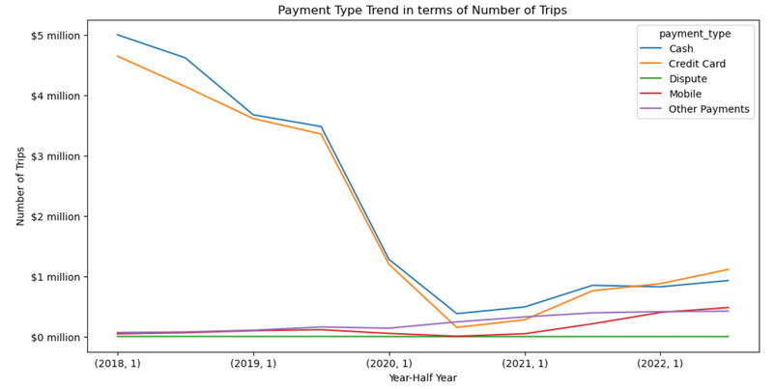
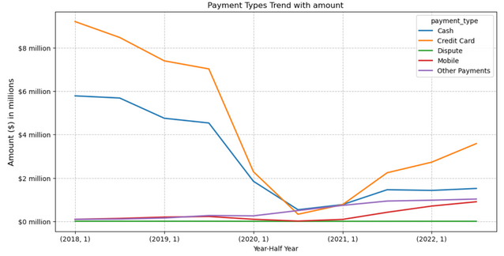

Holistic Trends
-- TRENDS OF PAYMENT METHODS CHANGING
Total trips dropped dramatically after Covid, increased again after Jan 2021
Credit card total payment amount increased faster than others
Notes:
4

Slide 11
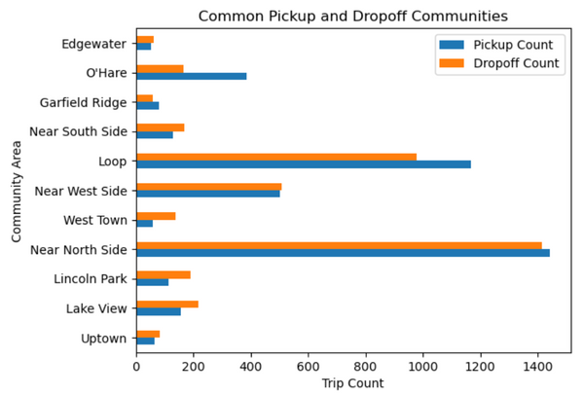
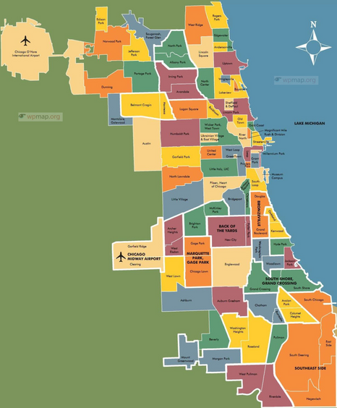
Pickup and Dropoff Locations
WHERE ARE THE HOT SPOTS FOR TAXIS
Locations with higher traffic flow have both more pickups and dropoffs
Passengers are departing Chicago O'Hare Airport, Loop and Near North Side
Taking ride to tourists attractions e.g. Lincoln Park and Lake View

Slide 12
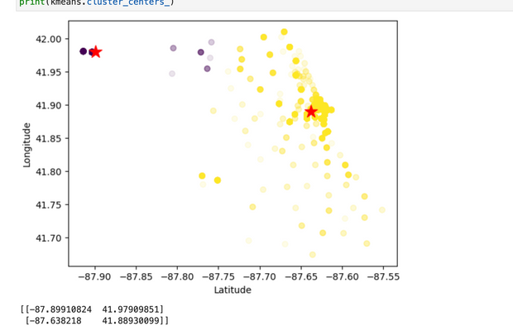
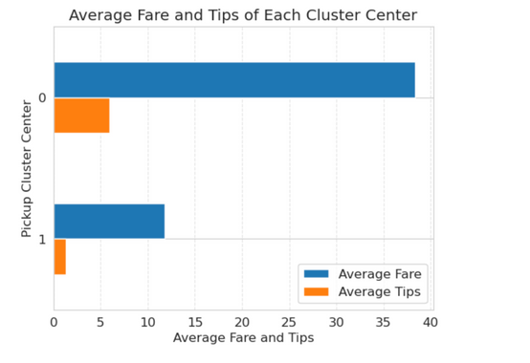
Additional Opportunity
MORE TRIPS VS HIGHER TIPS
Pickup Center 0: Chicago O'Hare Airport
Average 13.3 miles per trip, average fare $38.39, 15.5% tips.
Pickup Center 1: CBD
10 times more trips, average trip mile 2.7, average fare $11.77, 11.4% tips.

Slide 13
Conclusions
No strong variable correlation
Payment trends
Provide more convenient payment methods
Fare pricing strategies
prioritize miles and location, observe actions from top companies
Problem | Potential solution
Diminishing customer size | Create or merge platforms, exhibit DiDi
Weak correlation between variables | Categorize drivers and customers
Two centroids that are very saturated | Design and optimize routes

Slide 14

Thank you!

